Slide 1

Interim Oral Presentation
Michael Allport - Creating a 2.5d Tile-based Survival Game with custom Game Engine

Slide 2
Introduction
Project Aims
Game Engine / Rendering
Game – Procedurally generated world
Project Management
Git
Future plans

Slide 3
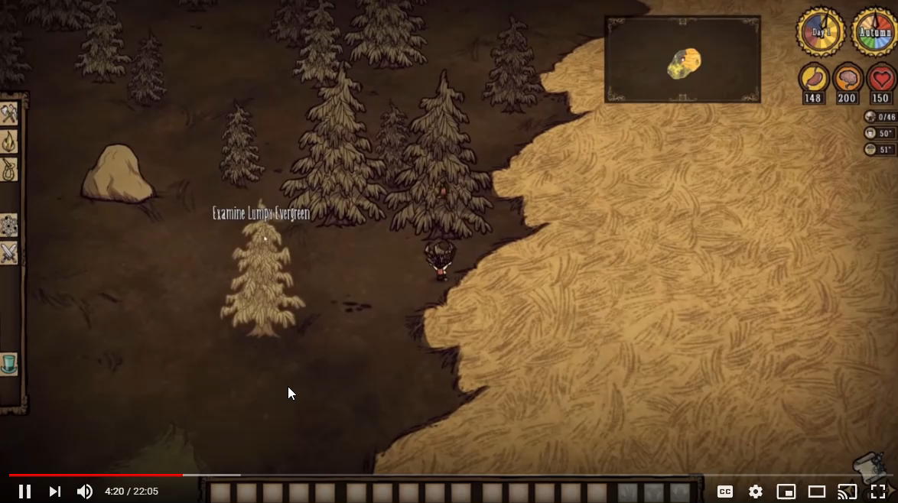
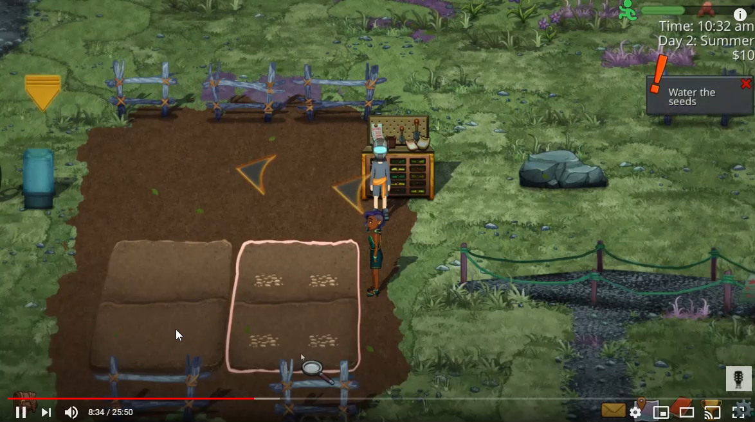
Project Aims
Don’t Starve [1]
Verdant Skies [2]

Slide 4
Project Aims
Language – C++
Targeted OS – Windows 10 x86/64
Procedurally generated content
Interactable world
5 minutes of gameplay

Slide 5
Game Engine – Rendering
Game Engine / Rendering

Slide 6
Game Engine – Rendering – OpenGL 101- Vertices and Indices
Vertex Data
Indices

Slide 7
Game Engine – Rendering – OpenGL 101- Buffers
Buffer sizeof(float) * 20
Assign layout, vertex array

Slide 8
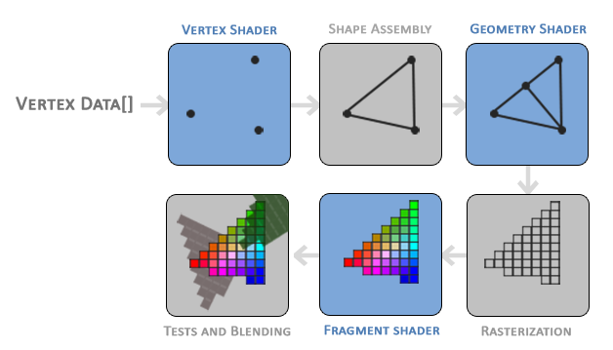
Game Engine – OpenGL - Pipeline
[3]

Slide 9
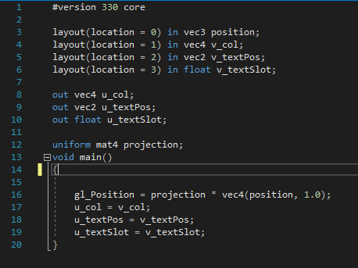
Game Engine – Rendering – OpenGL 101- Shaders
Shader program, instructions for GPU in Open GL Shader Language
Vertex Shader
Fragment shader (per pixel)
Basic vertex shader

Slide 10
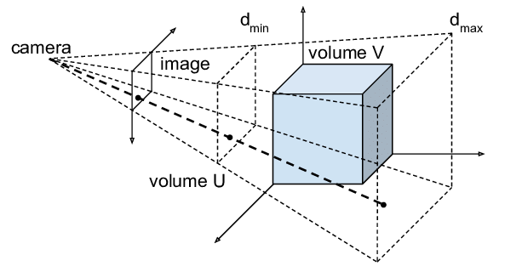
Game Engine – Rendering – Opengl 101 – Transformations
Projection, View, Model Matrices
Two main projections
Orthographic
Perspective
Post-Orthographic
Transformation
(Normalized device coordinates)
Pre-Orthographic
Transformation

Slide 11
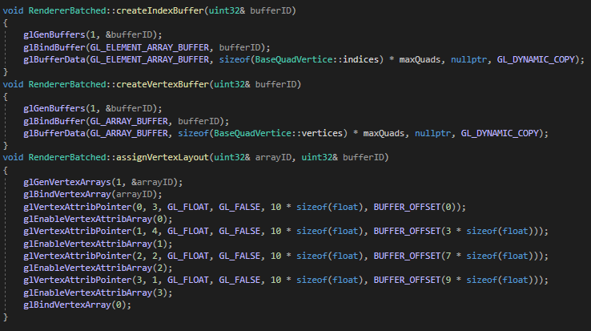
Game Engine – Rendering – Opengl 101 – The process
Create shader program
Create Vertex Buffer (allocate gpu memory) Create Vertex Array
Specify layout of bound buffer with Vertex Array
Create Index Buffer
Send data to buffers
Send uniforms to shader
Draw call, draw triangles * number of indices

Slide 12
Game Engine - Extras
Texture Loading / cache
Window operations
Logging
Event subsystem
Font renderer
Fig 2

Slide 13
Game – procedural World
Noise based procedurally generated world
(Diamond Square)
Live demo

Slide 14
Project Management
Project management utilities (Jira)

Slide 15
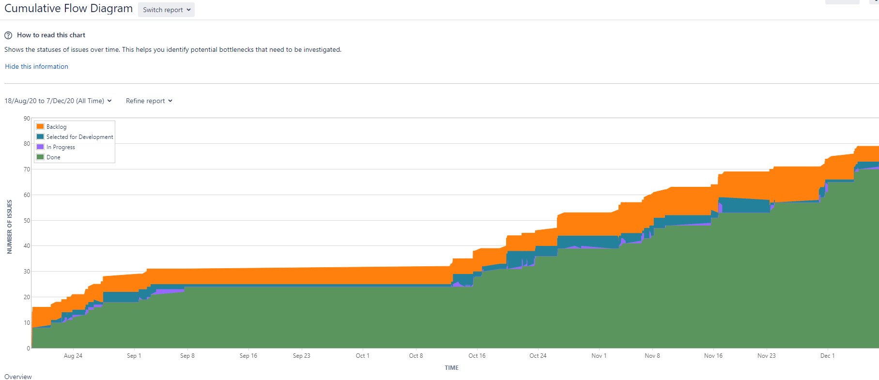
Project Management – Cumulative flow diagram
~80 tasks/stories created
~70 complete

Slide 16
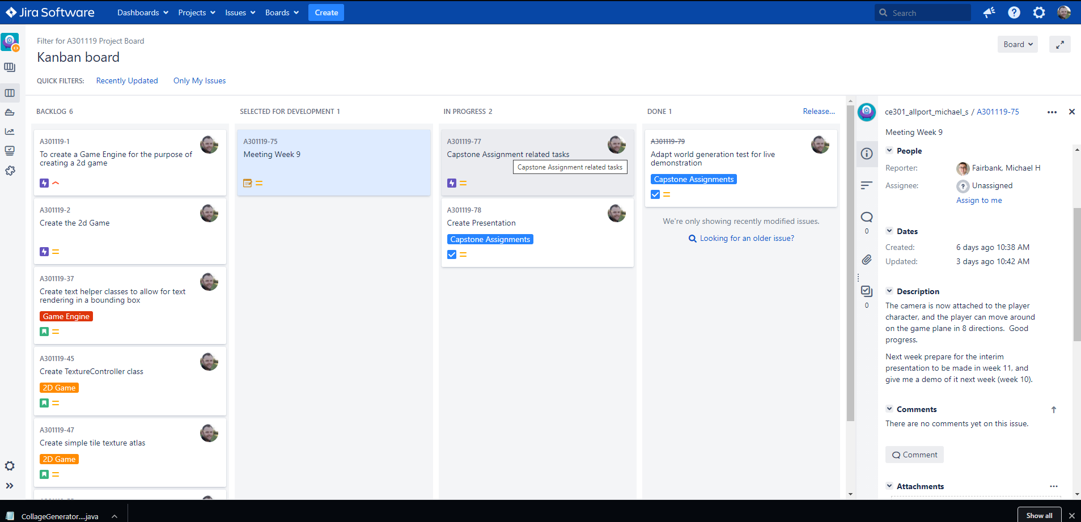
Project Management – Kanban Swim Lanes & Epics

Slide 17
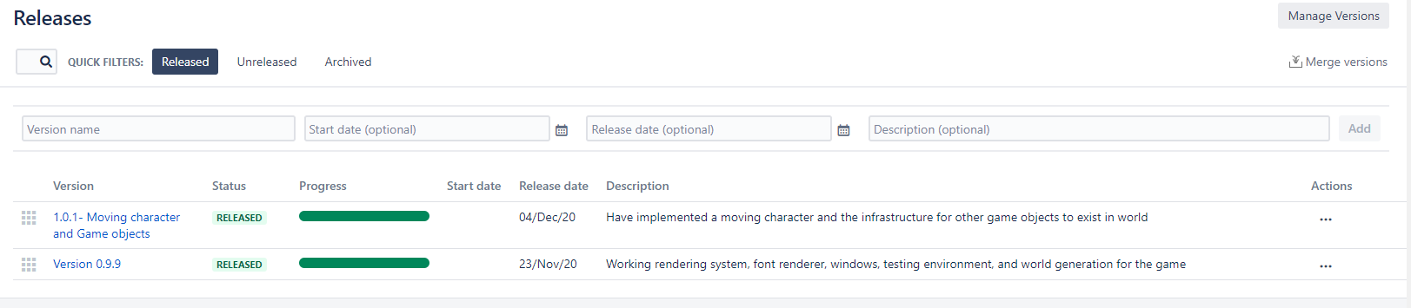
Project Management - Releases

Slide 18
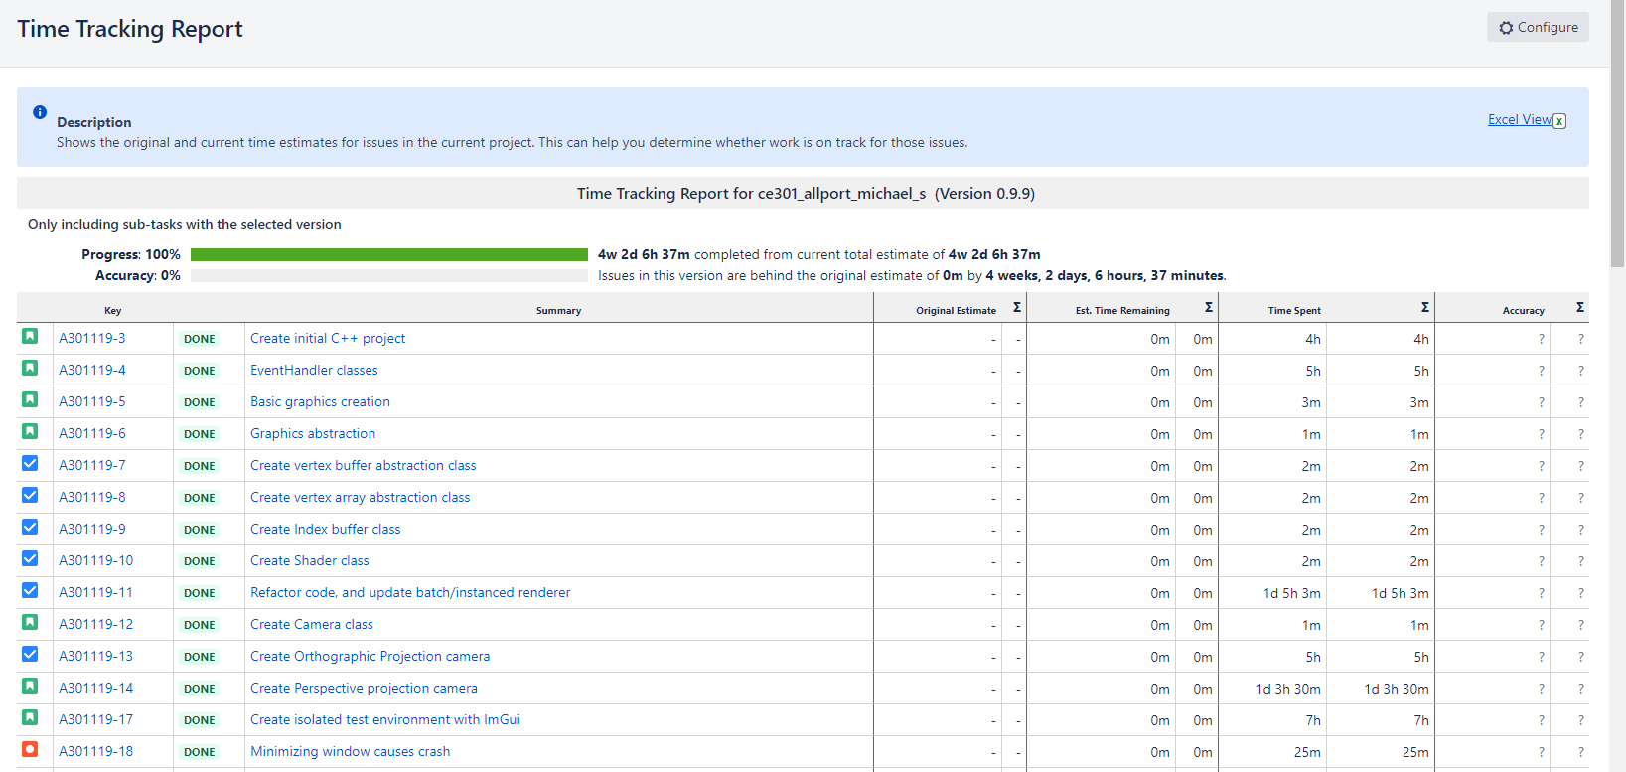
Project Management – Time v 0.9.9
4weeks 2days 6 hours 37 minutes
Total -182h 37min

Slide 19
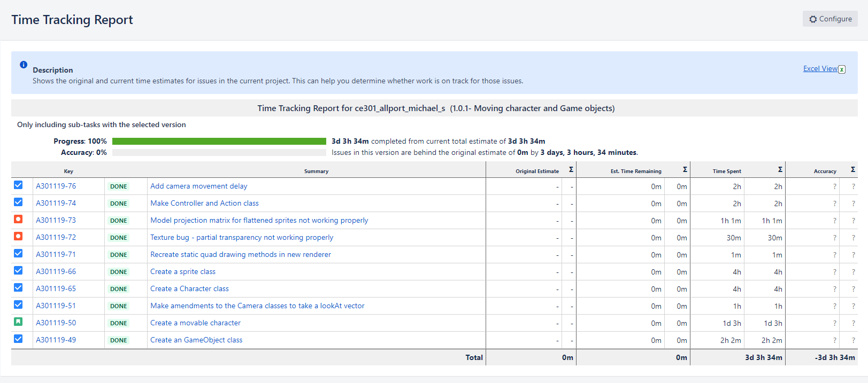
Project Management – Time v 0.1.1
3d 3h 34m
Total – 27h 34mins

Slide 20
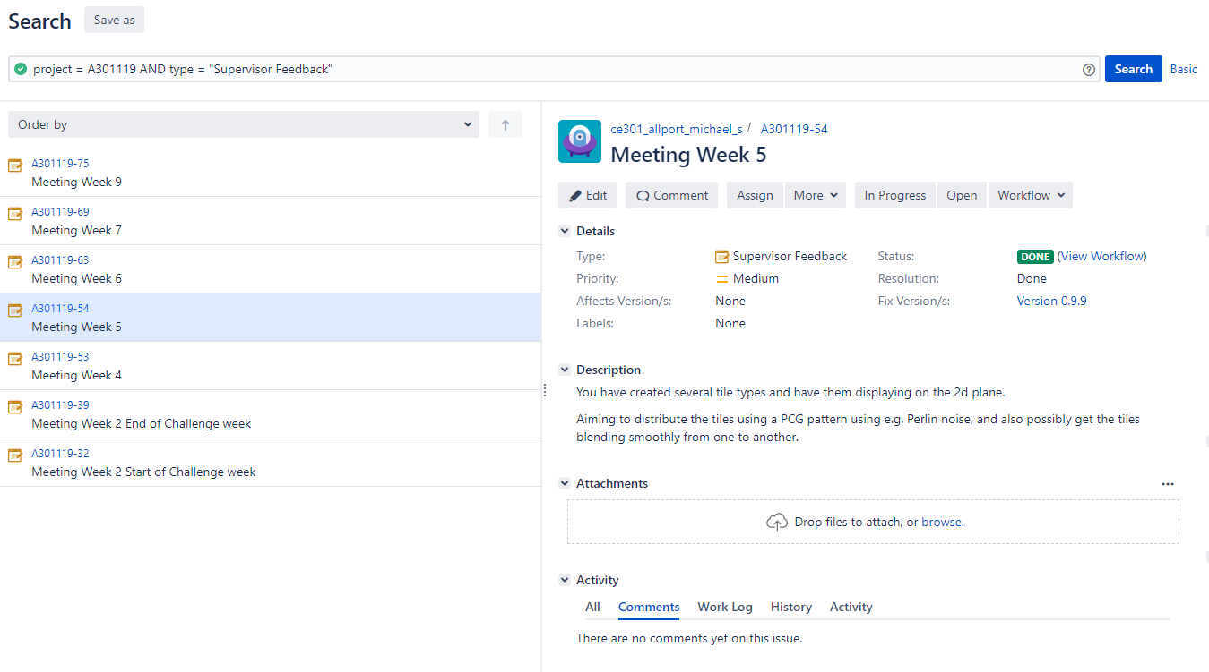
Project Management – Weekly planning

Slide 21
GIT
Git usage – Live demo

Slide 22
Future Plans
More Game Objects – trees, grass, stone, food sources etc
Procedurally populate world with objects
NPC’s – enemies and monsters
UI – inventory, simple crafting, food meter, health meter
Day/Night cycle

Slide 23

Thank You! Questions?
Michael Allport
Ma18533
1802882

Slide 24
Git Commits / links / reference
[1]Youtube.com, 2020. [Online]. Available: https://www.youtube.com/watch?v=NksfDyU80m4&t=273s. [Accessed: 08- Dec- 2020].
[2]Youtube.com, 2020. [Online]. Available: https://www.youtube.com/watch?v=q5APRllhQEU&t=564s. [Accessed: 08- Dec- 2020].
[3] de-Vries, J., 2020. Learn Opengl, Extensive Tutorial Resource For Learning Modern Opengl. [online] Learnopengl.com. Available at: <https://learnopengl.com/> [08- Dec- 2020].

